Slide 1
CSC-407 Project
By: Ioannis Batsios and Micah Roberts

Slide 2
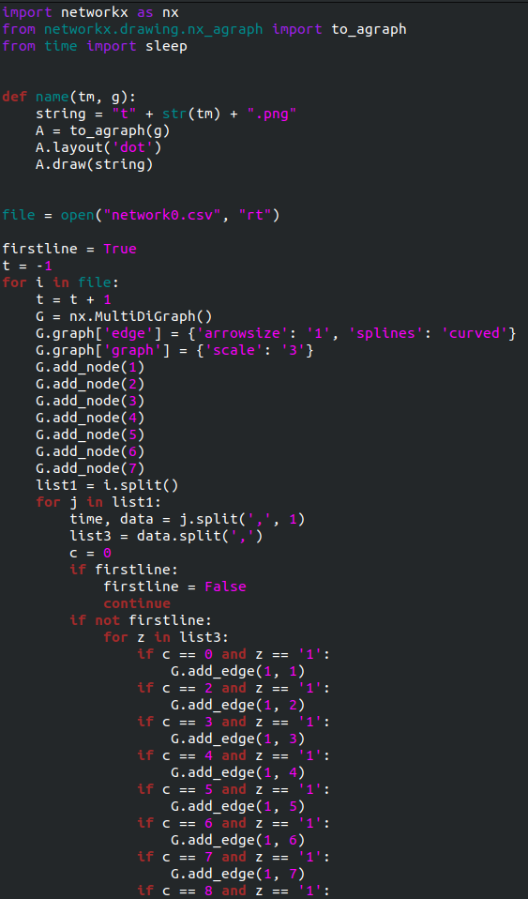
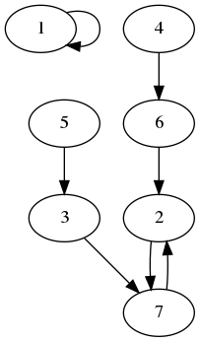
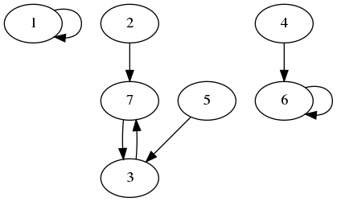
Algorithm and Data V1

Slide 3
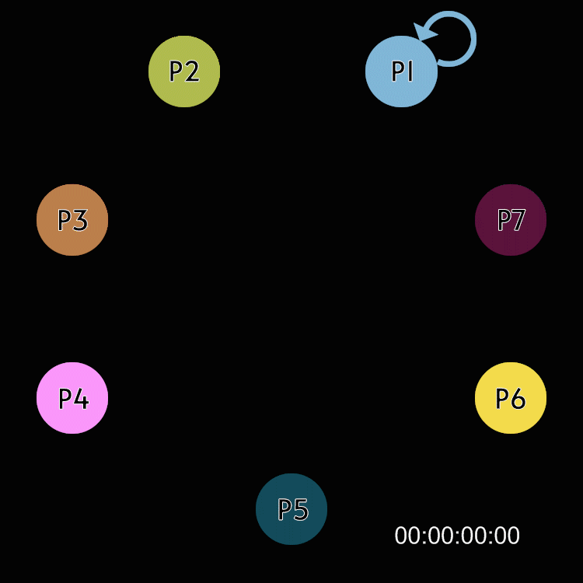
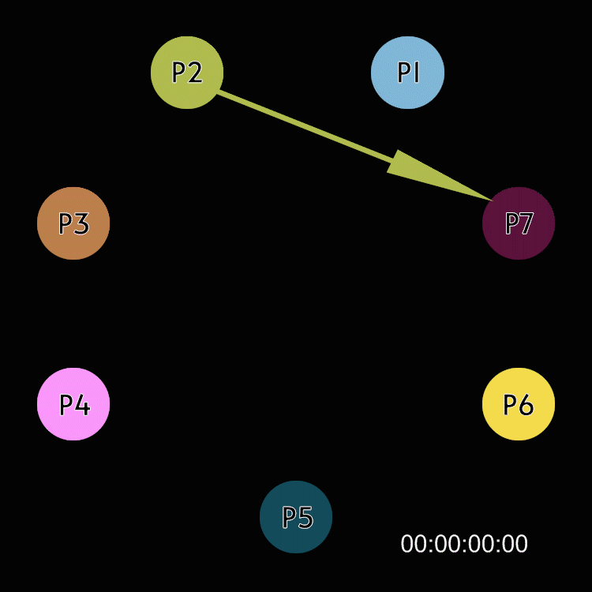
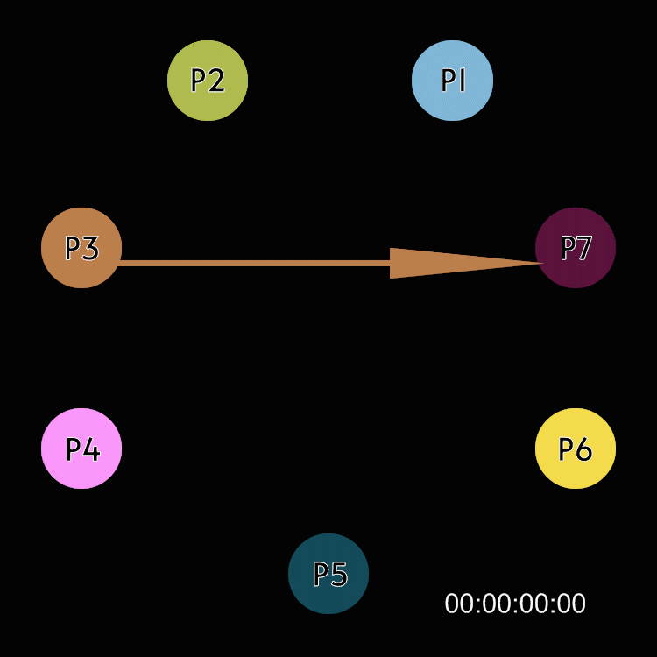
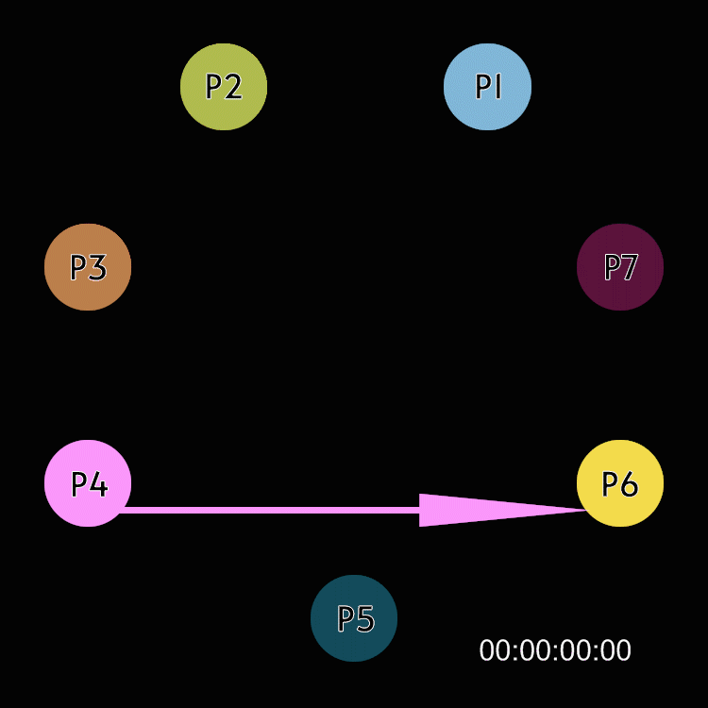
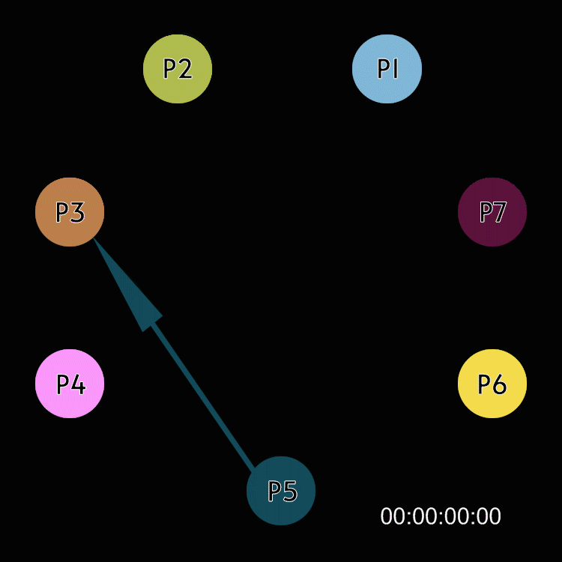
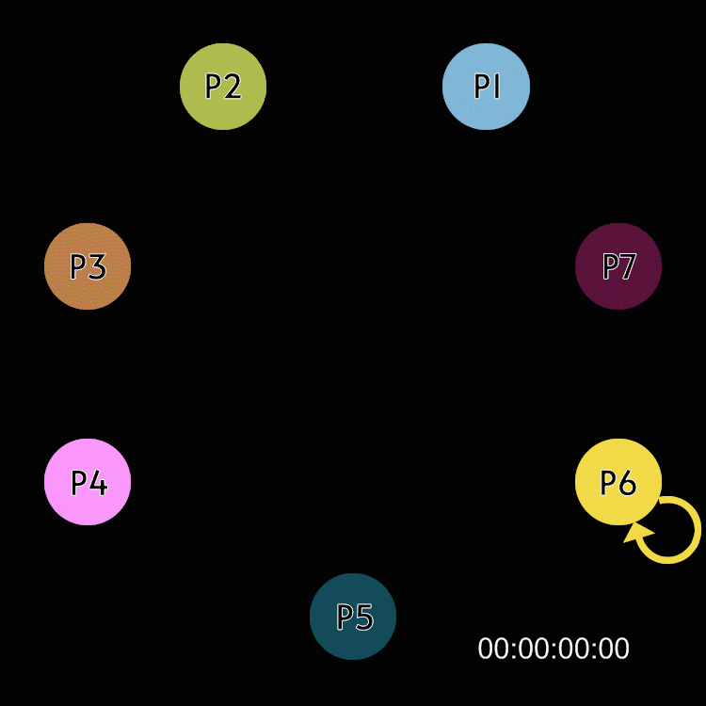
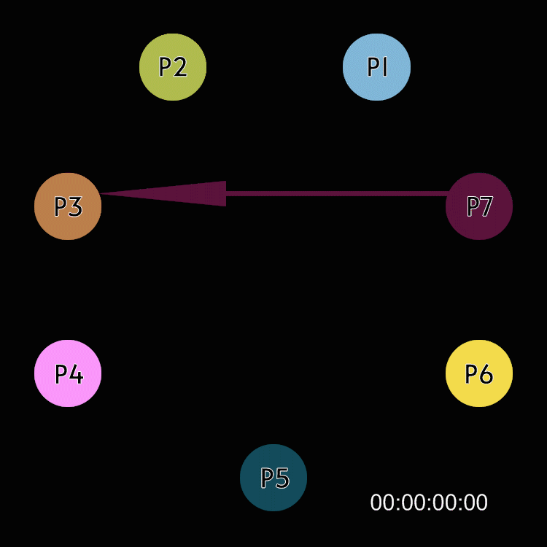
Single Node Visualization

Slide 4
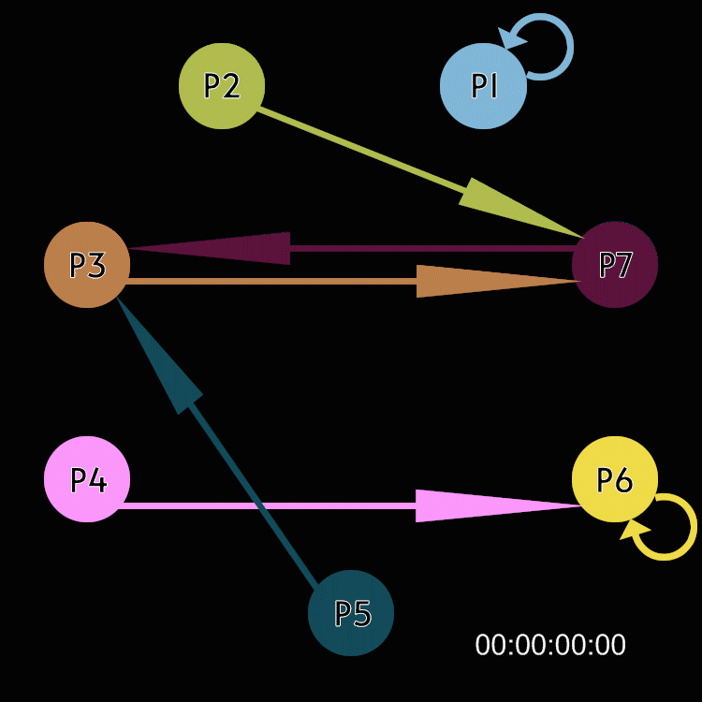
Complete Network Visualization

Slide 5
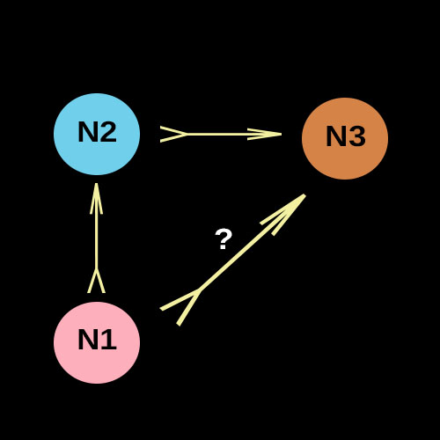
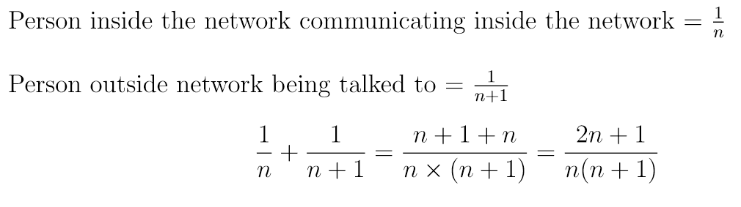
Probability of a new Node

Slide 6
Probability of a Rumor Spreading
2 people talking * proportion of the network * (1-proportion of the network) = 2 * 1/n (1-1/n)
n = 2 = 2* ½ (1 - ½) = 50% for n(2)
n = 3 = 2* 1/3 (1 – 1/3) = 44.4% for n(3)
n = 4 = 2* 1/4 (1 – ¼) = 37.5% for n(4)
n = 5 = 2* 1/5 (1 – 1/5) = 32% for n(5)
n = 100 = 2* 1/100 (1 – 1/100) = 2% for n(100)
Sources: https://www.youtube.com/watch?v=tgmOqWV9sow

Slide 7
Probability of a Weighted Rumor Spreading
Weight of popularity of node * proportion of the network * (1-proportion of the network)
Network 5 popularity:
N1 (popularity = .686) = .686 * .686 (1-.686) = 14.77%
N2 (popularity = .494) = .494 * .494 (1-.494) = 12.35%
N3 (popularity = .361) = .361 * .361 (1-.361) = 8.33%
N4 (popularity = .282) = .282 * .282 (1-.282) = 5.7%
N5 (popularity = .59) = .59 * .59 (1-.59) = 14.27%
N6 (popularity = .56) = .56 * .56 (1-.56) = 13.8%
N7 (popularity = .277) = .277 * .277 (1-.277) = 5.55%
N8 (popularity = .38) = .38 * .38 (1-.38) = 8.95%
Sources: https://www.youtube.com/watch?v=tgmOqWV9sow

